Slide 1
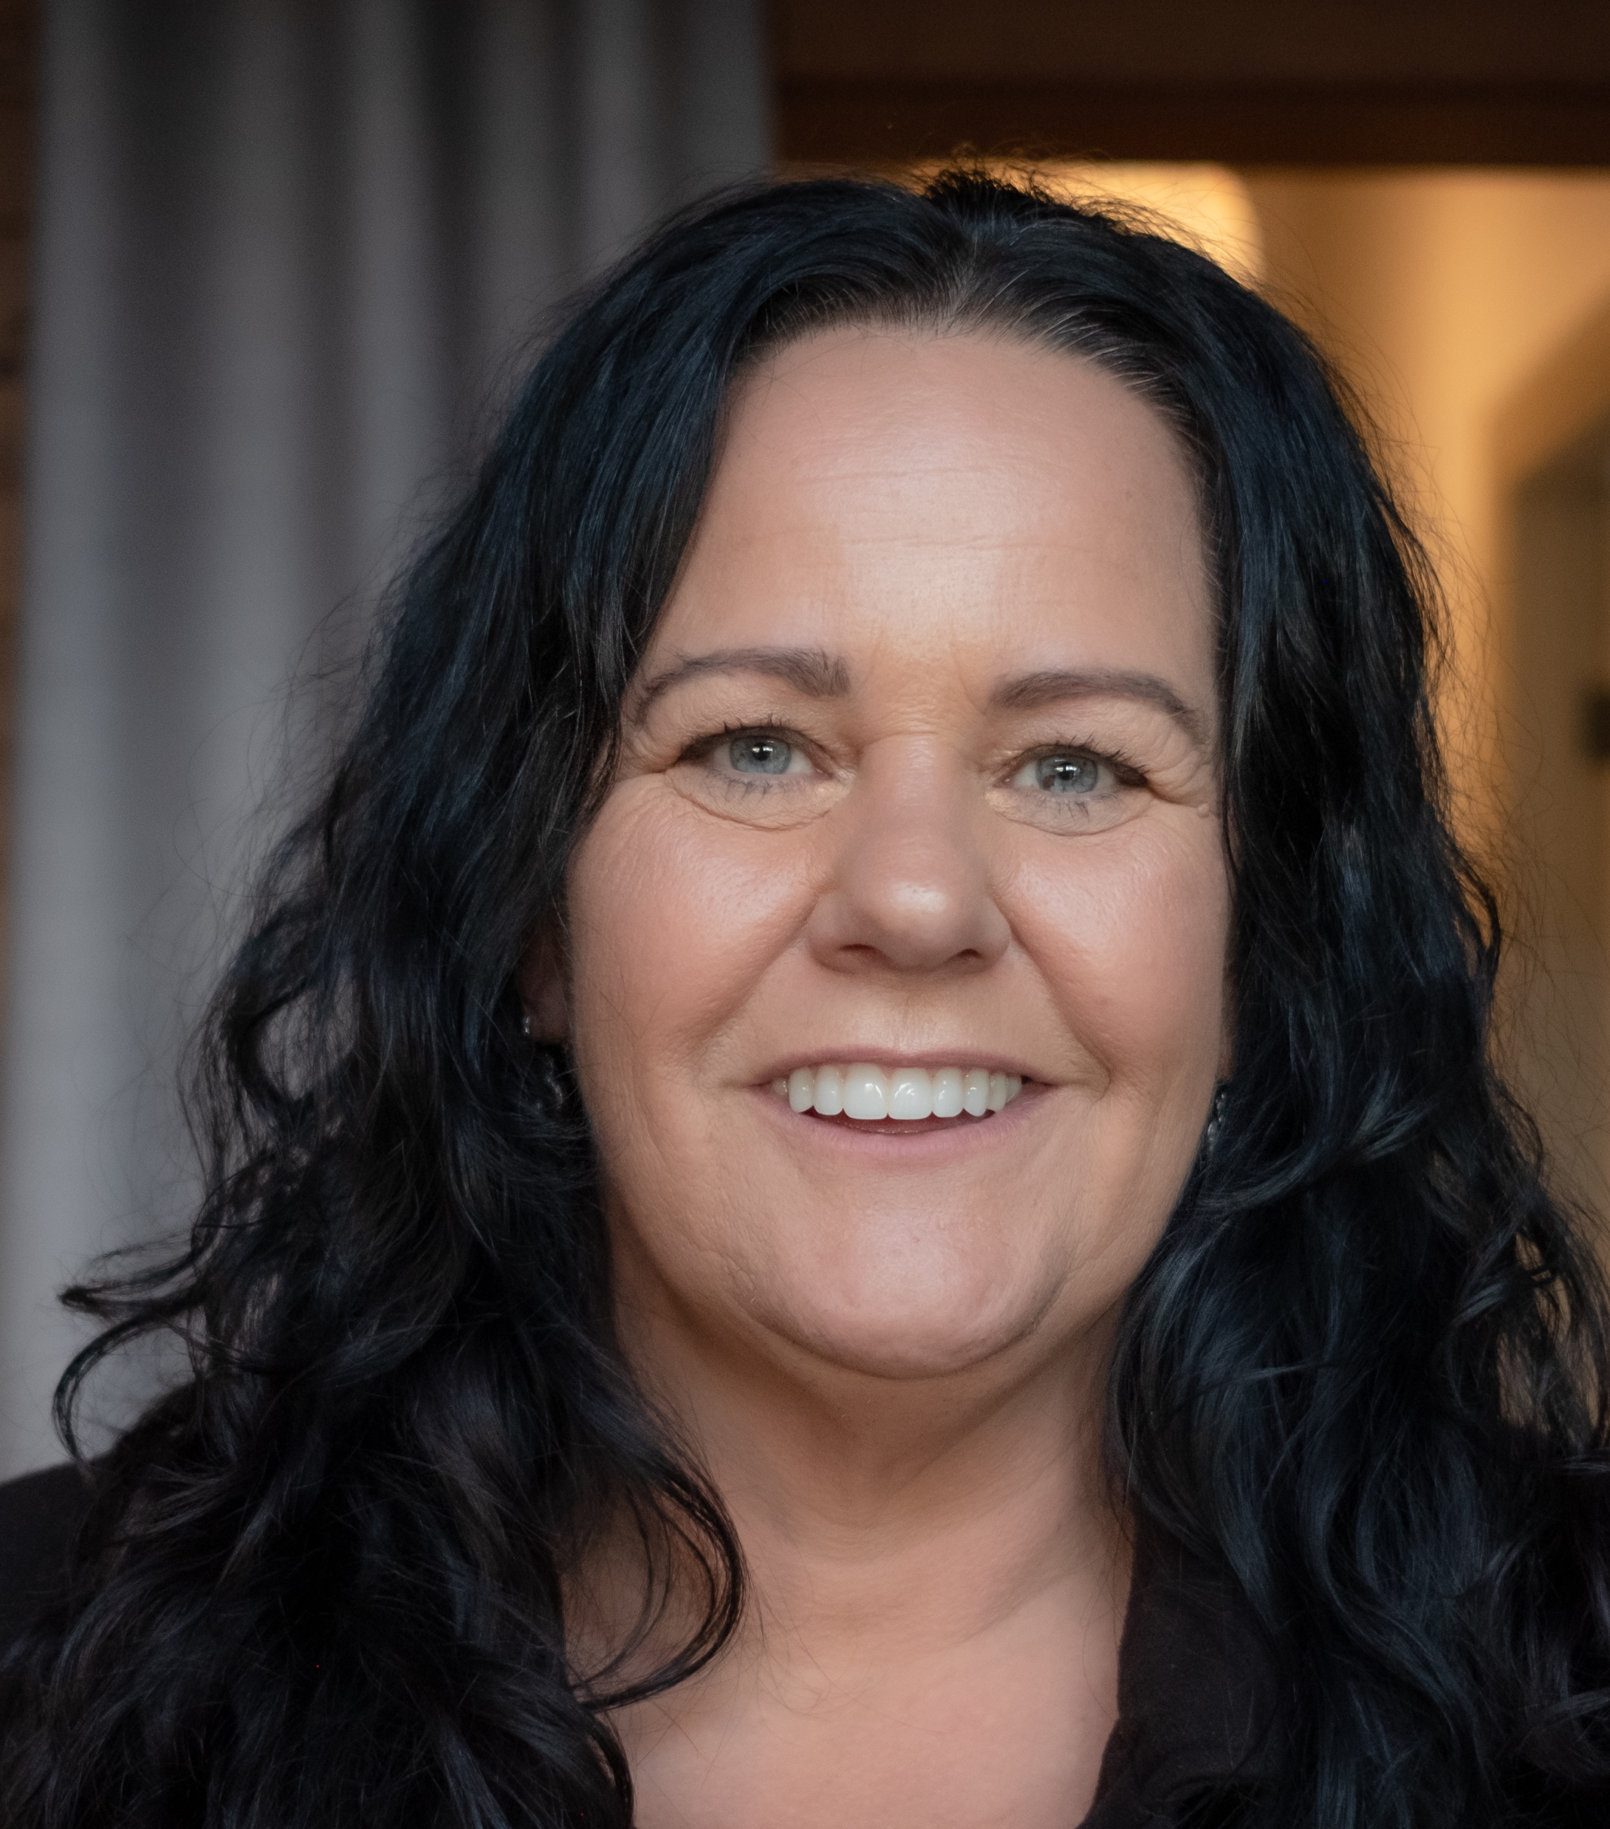
“It’s a very simple test that can give a lot of peace of mind”.
- Simone, Awabakal Country
Notes:
To change the photo, right-click in the centre of the image and select ‘change picture’, then upload the replacement photo.
Quote textbox is editable.

